Slide 1

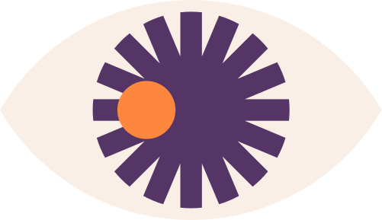
Web Engineering
React JS: Making Web Development Simple and Fun
ALIMA KHAN 19SW102

Slide 2


Hey,
Alima here!
Meet me a driven and passionate university student with a thirst for knowledge and a commitment to excellence, currently pursuing my bachelor's degree in Software Engineering from MUET. Passionate React JS developer with a strong front-end foundation, constantly exploring new ways to innovate and deliver high-quality web applications. Excited to collaborate and apply skills to new projects while continuously learning and growing as a developer.

Slide 3


My Expertise
05 | Python Programming , Skillful
06 | C++ , Skillful
07 | Java , Skillful
01 | HTML , Skillful
02 | JavaScript , Skillful
03 | React Js , Skillful
04 | Content Writer , Skillful
08 | DBMS , Beginner
09 | DevOps , Beginner

Slide 4



Brief Overview of ReactJs
React JS is an open-source JavaScript library for building user interfaces.
It was developed by Facebook and released in 2013, and has since become one of the most popular front-end development libraries in use.
React uses a component-based architecture, allowing developers to create modular, reusable UI components and improve code reusability.
React relies on a virtual DOM (Document Object Model) to optimize performance and improve user experience, updating only the necessary parts of the UI when changes occur.
React enables server-side rendering, enhancing SEO and page load times. With a large and active community,

Slide 5


As a university student, I was always drawn to the world of web development and creating engaging user experiences. One day, while browsing online forums and tech websites, I stumbled upon the term "React JS". Intrigued, I began to research further, reading articles and watching tutorials on this new technology.
What fascinated me about React JS was its unique approach to building user interfaces. The concept of creating reusable components and leveraging a virtual DOM for faster performance and improved user experience seemed like a game-changer. I was excited to learn more and dive deeper into the world of React JS development.
After hours of research and practice, I finally built my first React JS application. Seeing my code come to life on the screen, with smooth animations and seamless interactions, was an incredible feeling. From that moment on, I was hooked.
Since then, I have continued to explore and learn more about React JS, constantly pushing myself to improve my skills and build more innovative applications. What started as a chance discovery has become a true passion, and I am grateful every day for the opportunity to work in such an exciting and dynamic field.
How I got to know about ReactJS

Slide 6

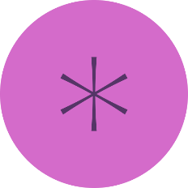

what seems fasinating?
React JS allows for the creation of reusable components, which saves time and effort in development and makes it easier to maintain and update applications.
React JS uses a virtual DOM, which makes it faster and more efficient than traditional approaches to web development, resulting in better performance and a smoother user experience.
React JS has a large and thriving ecosystem of third-party libraries and tools that help developers to build more sophisticated and innovative applications.

Slide 7


My current Achievements
2020-21
2023
2019
2020-21
2022
2023
I did my first internship as a front-end developer at LetsGrowMore
I did my second internship as a front-end developer at Interns.pk
Then I did my two major internships, one was Python Internship at Vezow and second as a Content Writer at TechInBorn
Currently I am working as an internee ReactJs developer in Ghani business Solutions.

Slide 8


Why you should choose ReactJs as your field
One compelling reason to choose React JS as a field is its popularity and demand in the job market. Many companies are now adopting React JS as their primary web development framework, leading to a high demand for skilled React JS developers. Additionally, React JS offers a unique approach to building user interfaces that promotes code reuse, faster rendering, and better performance, making it an exciting and dynamic field to work in. With a large and active community of developers constantly pushing the boundaries of what's possible with React JS, there are always new opportunities to learn, grow, and innovate in this field.

Slide 9

Pathway to follow for ReactJs
Start with the basics of JavaScript and HTML/CSS, as these are the building blocks of React JS. Familiarize yourself with concepts such as variables, functions, and loops. Learn the fundamentals of React JS, including JSX, components, state, and props. Practice building simple applications and gradually work your way up to more complex projects. Keep up with the latest trends and developments in React JS by following online resources such as blogs, forums, and social media groups. Attend meetups and conferences to network with other developers and stay up-to-date on best practices and emerging technologies.

Slide 10

Guidence
Pros of starting working with ReactJs
Some pros of starting to work with ReactJS include its flexibility, ability to create reusable components, and a large community of developers that provide support and resources. Additionally, React's popularity in the industry can lead to increased job opportunities and a higher demand for your skills as a developer.
Cons of starting to work with ReactJs
Some cons of starting to work with ReactJS include a steep learning curve for beginners, the need for additional tools and libraries to build a complete application, and the potential for performance issues with larger projects. Additionally, React's frequent updates and changes may require continuous learning and adaptation.

Slide 11


Future Goals
My future goals include expanding my skills beyond React JS to become a MERN stack developer, with the ability to create full-stack websites that incorporate both front-end and back-end development. With a strong foundation in React JS, I aim to learn MongoDB, Express, and Node.js to become proficient in the entire MERN stack.
Furthermore, I aspire to integrate AI and 3D models into my web development projects, leveraging emerging technologies to create more dynamic and engaging user experiences. With the rapid advancement of AI and machine learning, I believe there is immense potential for integrating these technologies into web development to create smarter, more intuitive applications. Similarly, 3D models can offer an immersive and visually stunning experience, adding a new dimension to web development.
By combining my skills in React JS with the MERN stack, AI, and 3D modeling, I hope to create innovative web applications that push the boundaries of what's possible in web development.

Slide 12




GITHUB
https://github.com/Alimabear/Hand-Gesture-Volume-Controller
EMAIL
alimaaarshad20@gmail.com
Alima 19SW102

